Slide 1

Appendix E – Case Study: The Visual Aid

Slide 2
Motivation
Examine a student case study that demonstrates application of principles in the text.
Appendix E contains a condensed version of the case study.
The complete project report, as well as others, can be found at www.mhhe.com/fordcoulston .

Slide 3
The Visual Aid
Ryan Andrus, Luis Catoni, Carl Schnur, and Freddy Chiu
A Senior Project Report Submitted to the Faculty of
Electrical, Computer, and Software Engineering
Penn State Erie, The Behrend College
April 2006

Slide 4
Need Statement
Visually impaired people often have mobility difficulties due to limited spatial sensing—determining where objects are. Although many receive education in mobility techniques and enhance other senses to create better awareness of surroundings, there is a need for a more accurate spatial description. For example, according to the Vision and Blindness Resources Center in Erie, visually impaired people are able to detect walls due to different sounds in the environment.

Slide 5
Need Statement, cont’d
However, a tree branch, stairs, or a street sign may be undetected. Due to objects that cannot be perceived by sensorial means, many devices have been designed to detect objects in the path of a visually impaired individual. Common mobility resources are guide dogs, canes, and electronic travel aid (ETA) devices. Unfortunately, these resources are either limited or too expensive. There is a need for a device to provide an effective way to detect objects and be cost-efficient.

Slide 6
Objective Statement
The goal is to design and implement a digital system that give visually impaired an enhanced awareness of their surroundings. The system will detect objects and provide real-time feedback to the user according to the size, position, and distance of the object.

Slide 7
Research Survey
The team
identified competing products
Found statistics of visually impaired usage of navigation methods
Visited interviewed a local center on Vision and Blindness resources to identify user needs
Identified needs and common hazards

Slide 8
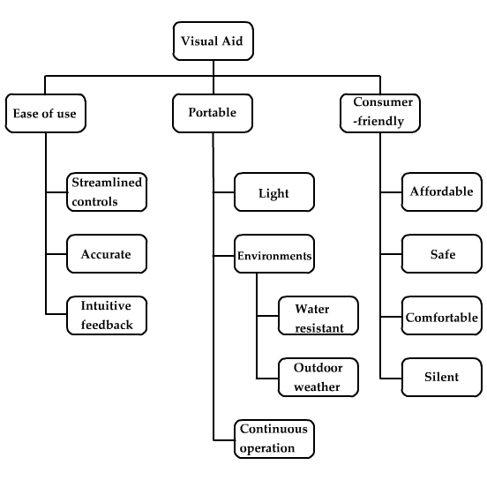
Objective Tree

Slide 9
Requirements Specification
Marketing Requirements | Engineering Requirements | Justification
1, 2, 10, 13 | The system’s total weight will not exceed 5 lbs. | Based on the weight of other portable devices, such as laptops, and the weight of book bags.
7, 8, 13 | The system will have a single control to turn it on/off. | Based on the user’s need for the system to be as simple and intuitive as possible and the average person’s familiarity with technology.
5, 13 | The system will operate on full charge for at least 3 hours. | Based on the expected daily use by considering average daily walking time (2.1 miles at 3.3MPH≈38 minutes/day) by a factor of approximately 5.
6 | The system should not exceed $600. | Based on the cost of competing products [6], such as the LaserCane.

Slide 10
Requirements Specification, cont’d
11 | Uneven surfaces (steps, rocks) of at least ±1.25in high will be detected at a distance of at least 3 ft away from the user. | Based on the size of possible hazards, such as rocks, bottles, sign posts, stairs, etc.
11, 14 | The system will detect objects that are at least 1in wide and 2in high at a distance of at least 3 ft from the user and as far as 7 ft in an area 2 ft wide, and provide sensory feedback. Also, the system should detect street signs and posts. | Based on the user’s need to timely and intuitively be notified of hazards.
12 | The system should not produce noise exceeding 40db. | Based on comparisons of sound levels at an office, bedroom and living room environment [7].
3 | The system will be built with components that can operate in temperatures ranging from 0˚F to 120˚F. | Based on the expected range of temperatures the user might operate the device in.

Slide 11
Requirements Specification, cont’d
3, 4, 9 | The system components will be enclosed to be water-resistant. | Based on outdoor environments and its conditions (snow, rain, humidity) the user might face and the need for the user to be protected from electrical shock.
14 | The system will refresh its output according to sensor readings 5 times per second. | Based on the average reaction time of humans (0.33 seconds) [8].
Marketing Requirements 1) Portability, 2) Weight, 3) Operable Environments, 4) Water Resistant,5)Operation Time, 6) Cost, 7) Ease of use, 8) Streamlined Controls, 9) Safety, 10) Comfortable, 11) Accurate, 12) Noise Level, 13) Consumer-Friendly, 14) Intuitive Feedback

Slide 12
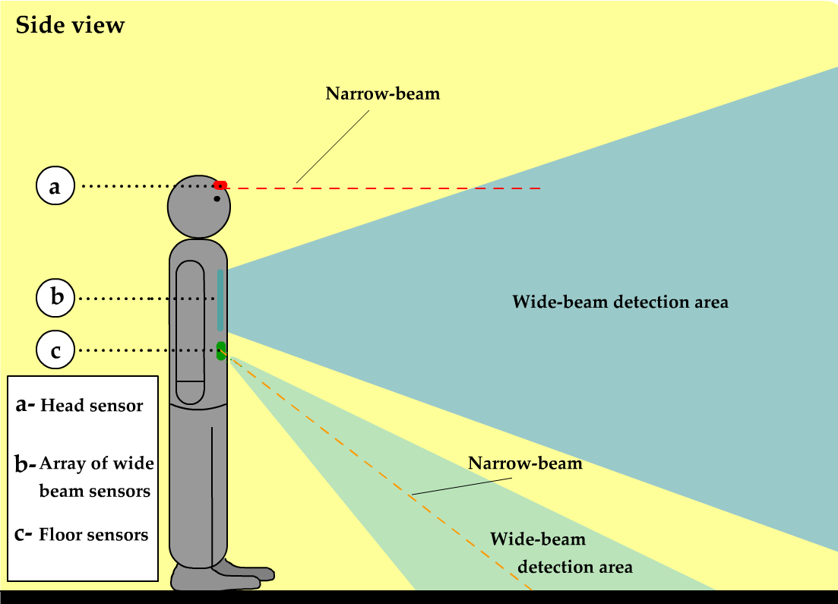
E.3 The Design
Physical view

Slide 13
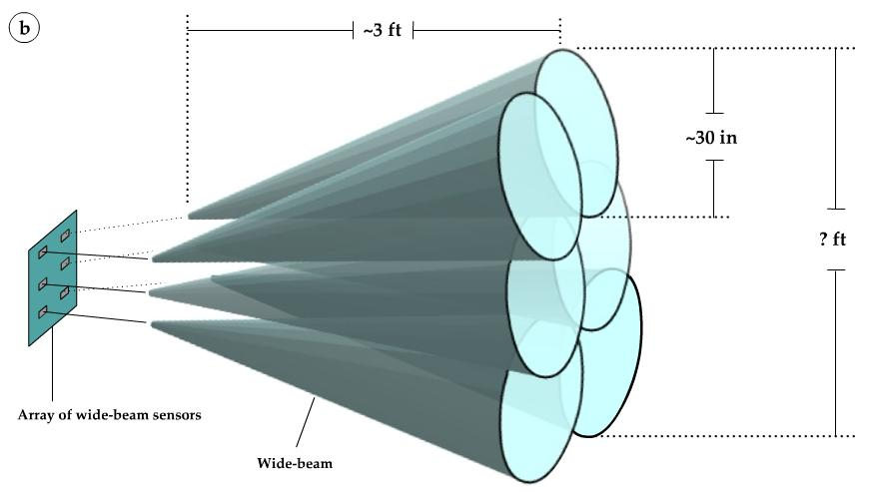
Wide Beam Sensor Array

Slide 14
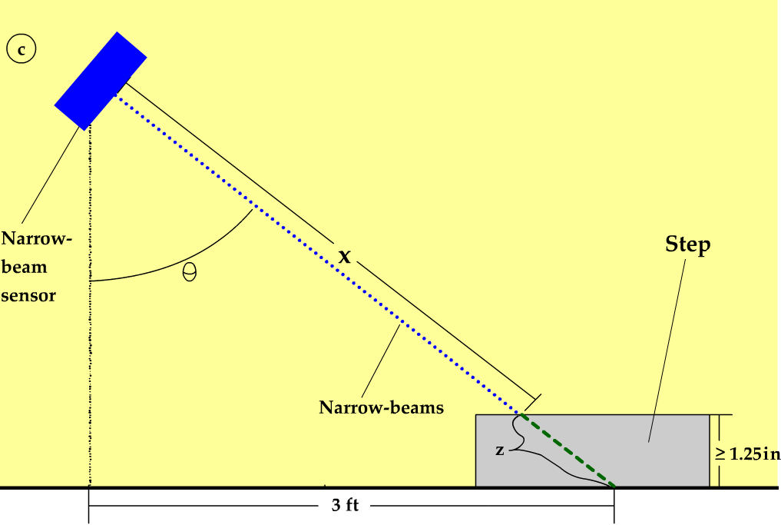
Narrow Beam Sensor

Slide 15
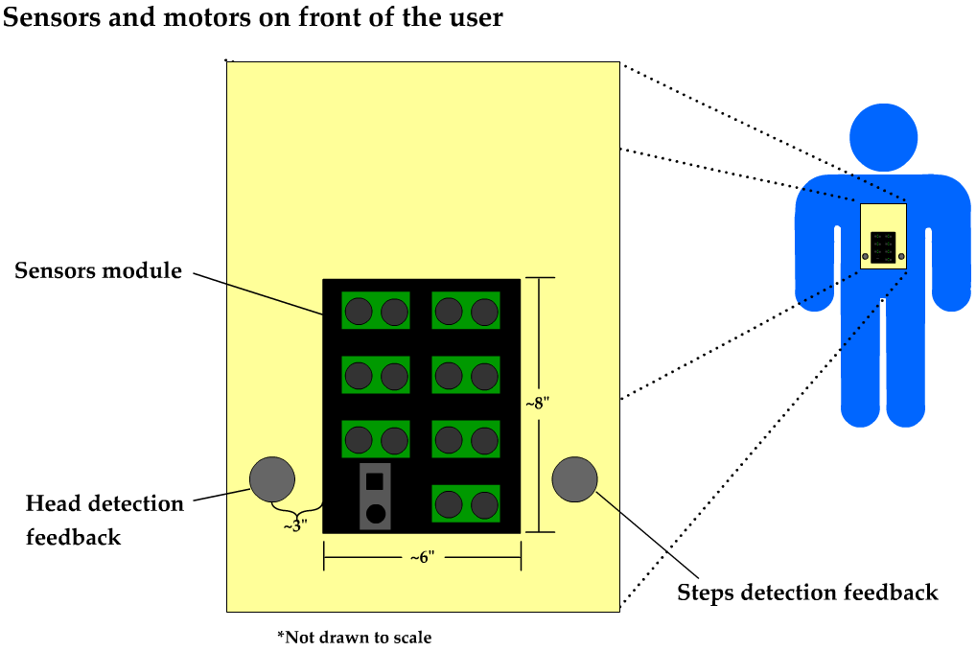
Sensors and Front Motors

Slide 16
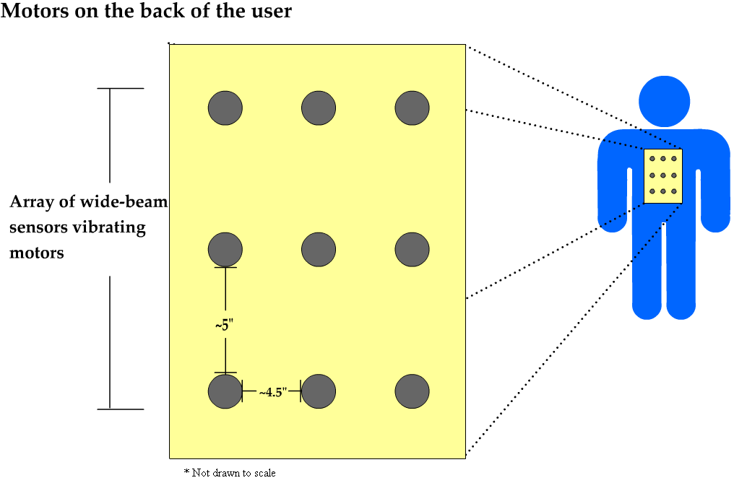
The Motors Matrix

Slide 17
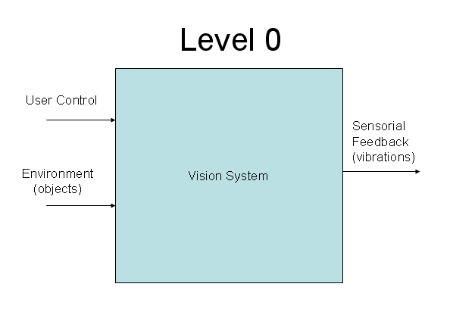
The Functional Decomposition
Module | Vision System
Inputs | - User control: on/off - Environment (objects): objects at least 1 in. wide and 2 in. high found in a 2 ft. wide area in front of the user, including steps.
Outputs | - Sensorial feedback (vibrations): a 3x3 matrix of vibrating motors, plus three additional vibrating motors.
Functionality | Alerts the user intuitively by means of vibrating motors as to what area and distance in front of the user object(s) is(are) and/or if there is a step. Detected objects are at least 1 in. wide and 2 in. high at a distance of at least 3 ft. from the user and as far as 7 ft. in an area 2 ft. wide. Variations of height (steps, rocks) of at least ±1.25 in. are detected at a distance of at least 3 ft. away from the user.

Slide 18
Level 1Diagam

Slide 19
Level 1 Specs (some)
Module | Ultrasonic Sensor Bank
Inputs | - 5V DC for power. - Environment (objects): objects at least 1in wide and 2in high found in a 2ft wide area in front of the user. - D₀-D₇: forwarded 5V DC 10µs control signal from PIC to selected sensor.
Outputs | - U₀-U₇: 0-5V DC pulse signal from 100µs to 18ms corresponding to selected sensor.
Functionality | Detects objects on the floor and in front of the user (under head level), and gives feedback regarding location and distance to object.
Module | PIC 18F452
Inputs | - 5V DC for power. - R₀-R₂: analog voltage feedback from 0.55Vto 2.8V - U_{X}: 0-5V DC pulse signal from 100µs to 18ms.
Outputs | - S₀-S₂: digital select lines - U_{C}: 5V DC 10µs pulse - M₀-M₁₁: PWM signals with ? period and ?% duty cycle
Functionality | Gather data from ultrasonic and IR sensors, then convert it to PWM signals that drive the vibrating motors.

Slide 20
Concept Selection
Method | Advantages | Disadvantages
Ultrasonic sensor | Wide range Inexpensive | Less accurate
IR sensor | Accurate Inexpensive | Limited scope and range
Lasers | Accurate Long distance detection | Expensive Limited scope
Radar | Infinite range Near perfect accuracy | Very expensive Large and heavy Expert knowledge required
Method | Advantages | Disadvantages
Vibration | Quiet operation Inexpensive | May take time for user to get used to this type of sensorial feedback
Audible | Unlimited capability | Interferes with a blind user’s vital hearing ability

Slide 21
Software Design Description (state diagram)

Slide 22
Unit Testing – IR Sensor
Test Name: IR Sensor Test |  |  |  |  | Test Number: 101
Test Description: Verify that the IR sensor is correctly reading distance without unnecessary noise.
Test Information
Name of Tester: Luis |  | Date: 3/18/06 |  |  |  | Time: 2:00PM
# | Procedure | Pass | Fail | N/A |  | Comments
1 | Mount the IR Sensor and hold it vertically at waist level. | x
2 | Start Recording data while walking along a flat, obstacle-free path. | x
3 | Analyze that data to ensure that minimal noise is created from the up and down movement of walking. | x |  |  |  | Used Luis, Carl, and a rolling cart.
4 | Repeat test with stairs along the walking path. | x
5 | Analyze the values to ensure that they differ enough from data along the flat surface. | x |  |  |  | See data on next page for plots with different filters used.

Slide 23
Unit Testing – IR Sensor (data)

Slide 24
Integration Test – IR Sensor & Motor
Test Name: Ultrasonic Sensor/Motor Test |  |  |  |  | Test Number: 200
Test Description:
Test Information
Name of Tester: Freddy and Ryan |  | Date: 3/25/06 |  |  |  | Time: 1:00PM
# | Procedure | Pass | Fail | N/A |  | Comments
1 | The tester should be wearing the visual aid system with the ultrasonic sensors and vibrating motors properly installed. | x
2 | Have someone place and object in the path of each individual sensor. | x
3 | Verify that the user is able to identify which position on the vibrating motor bank is being activated. Also, ensure the correct motor is being activated. | x
4 | Repeat step (3) for each ultrasonic sensor combination in order to activate each vibrating motor separately. | x
5 | Next, repeat the same procedure but activate multiple ultrasonic sensors and vibrating motors simultaneously and ensure that the unit is functioning properly. | x |  |  |  | See conclusions below.

Slide 25
Acceptance Test for one of the Engineering Requirements
Test Name: Object Detection Test |  |  |  |  | Test Number: 305
Test Description: Verify that the system can detect objects that are at least 1in wide and 2in high at a distance of at least 3 ft from the user and as far as 7 ft in an area 2 ft wide, and provide sensory feedback. Also, the system should detect street signs and posts
Test Information
Name of Tester: Freddy and Ryan |  | Date: 3/18/06 |  |  |  | Time: 12:30PM
# | Procedure | Pass | Fail | N/A |  | Comments
1 | On a flat level surface first mark a spot which is where the system will take readings from. | x
2 | Next, mark out a rectangular box on the floor, starting 3 feet from the testing position. The box should be centered with the testing spot and be 2 feet wide and 4 feet long. This box is used as reference for placing objects. (See comments) | X |  |  |  | X

Slide 26
Acceptance Test, cont’d
3 | Place a small object which is approximately 1” wide and 2” high across the front line (Left Corner, Right Corner and Middle). Verify that the object is detected at each position and the appropriate motors are activated. | X |  |  | x x x
4 | Now, repeat step (3) but place the object across the back line. | X |  |  | x x x
5 | Again, repeat step (3) but place the object across the center of the box. | x |  |  | x x x
6 | Record all results and repeat test with objects of different sizes (poles, chairs, etc…) to ensure proper detection. | x |  |  | To verify this test we set up an obstacle course with objects which the user had to navigate through. See video for results of this test.

Slide 27
Requirements Verification
Engineering Requirement | Test Verification
The system’s total weight will not exceed 5 lbs. | Showed that weight did not exceed 5 lbs. Test: Weight Test Test #: 300
The system will have a single control to turn it on/off | Showed that ON/OFF switch works properly.(Sometimes needs switched twice) Test: On/Off Switch Test Test #: 301
The system will operate on full charge for at least 3 hours | Showed that the system will operate for at least 3 hours under normal conditions. Test: Full Charge Operation Time Test #: 302
The system should not exceed $600 | Showed that the total expenses to construct the system did not exceed $600 budget. Test: Budget Test Test #: 303
Uneven surfaces (steps, rocks) of at least ±1.25in high are detected at a distance of at least 3 ft away from the user | Showed that the system can properly detect uneven surfaces. Test: Uneven Surface Test Test #: 304

Slide 28
Requirements Verification, cont’d
The system will detect objects that are at least 1in wide and 2in high at a distance of at least 3 ft from the user and as far as 7 ft in an area 2 ft wide, and provide sensory feedback. Also, the system should detect street signs and posts. | Showed that the system can properly detect objects of a minimum size in within the boundaries of the test area. Test: Object Detection Test Test #: 305
The system should not produce noise exceeding 40db | Showed that system noise is < 40db and is not distracting during quiet conversation. Test: Sound Level Test Test #: 306
The system is built with components that can operate in temperatures ranging from 0˚F to 120˚F | Showed that all components of system will operate properly with the temperature range. Test: Operating Environment Temperature Test #: 307
The system components is enclosed to be water-resistant | Components are not sealed in our prototype. Could be made water-resistant and tested. Test: Water Resistant Test Test #: 308
The system will refresh its output according to sensor readings 5 times per second | Showed that the system will refresh its output at least 5 times per second. Test: Refreshing System Output Test Test #: 309

